Slide 1

Common tools to break and fix wireless protocols
Why WEP and WPA is bad and why you should use WPA2
(for now)

Slide 2

Introduction
I.E. Why should I care?

Slide 3
Introduction
People use wireless protocols and encryption everyday to use laptops, cell phones, and other wireless enabled devices.
We “broadcast” our information over the air and anyone with special software can intercept this information.
The network itself may be in danger if the encryption is broken.

Slide 4
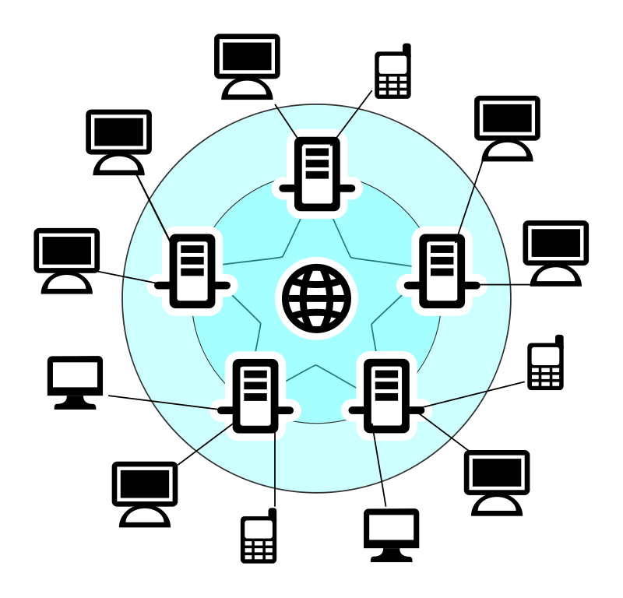
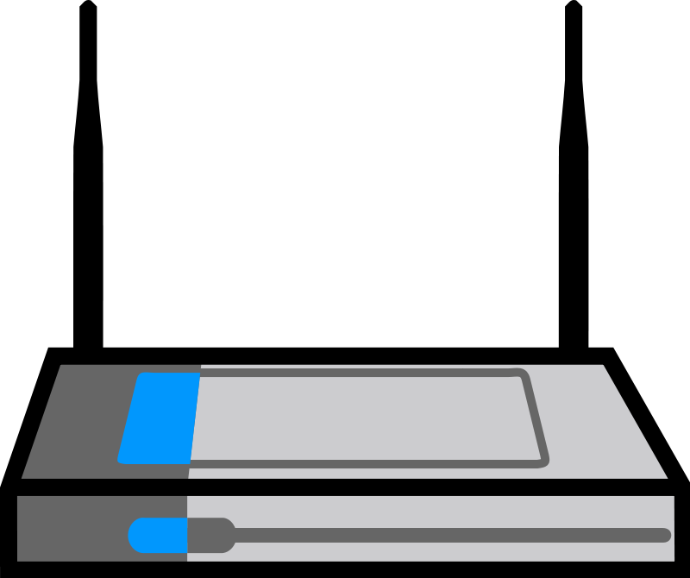


Typical home network topology
Internet
Wifi
Router
Bob
Bill
Alice

Slide 5

If the network security was cracked, what is compromised?

Slide 6
Wifi encryption
Encrypting any traffic sent between any wifi device.
Most common Protocols:
  WEP - Wired Equivalent Privacy
  WPA - Wi-Fi Protected Access
  WPA2 - Wi-Fi Protected Access 2

Slide 7
Easy to crack: WEP
WEP is now susceptible to many attacks.
Interception of wireless packets. Records all traffic to and from a set of computers that use the WEP protocol.
The more active the network is, the more susceptible the network.
Attacker can also use packet injection to stimulate the network.

Slide 8
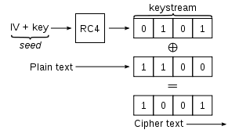
Known vulnerabilities to
WEP uses a nonce from the RC4 algorithm.
  IV creates a pseudo random initialization vector of 24 bits for the RC4 Algorithm.
  Problem: RC4 needs a unique nonce to work properly. WEP does not allocate enough bits for nonce, which means it reuses the nonce.

Slide 9
Shared key flaw
All computers have a shared key. If the key is compromised, traffic from the router to the other computers could be decrypted as well (as long as no other underlining encryption is occurring).

Slide 10
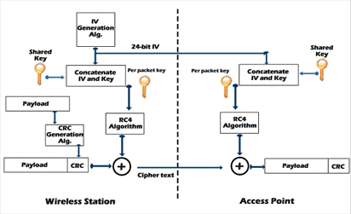
Overall picture

Slide 11
Tools used to crack WEP
DEMO: KisMAC (Mac) - Mac tool used in this Demo.
Backtrack 4 (Linux) - Linux distribution that includes tools for wireless security auditing.
Aircrack (Windows) - Windows toolset for wireless auditing.
All three of these tools can be used to crack WEP and WPA.

Slide 12
PASSIVE PACKET SNIFFING
Wireless sniffer - A program that will look at all traffic in the area, even hidden Wifi signals. Will also record information such as data packets and management packets.
Data packets contain unique IV’s in the WEP.
When enough (over 100,000) of these unique IV’s are collected, known attacks such as the “Weak Scheduling attack” for 40 and 104 bit WEP encryption can be run.
Can take a long time but works with almost any hardware.

Slide 13
DEMO WEP cracking
I will be using KisMAC to demonstrate how an attacker might gain control of a system with WEP Wifi encryption.
Server
Client
Attacker/packet sniffing

Slide 14
WEP cracking with data injection
By creating own packets and sending with know data, one can deduce the IV’s much quicker.
Uses special hardware (Wireless USB) to attack a network.
No additional traffic needed from other computers.
Server
Attacker/packet sniffing

Slide 15
How to fix
Most routers and ad-hoc networks support WPA and WPA 2.
The only known attacks on WPA and WPA 2 are brute force algorithms so they take significantly longer.
Uses Temporal Key Integrity Protocol (TKIP) and AES support to provide extra security.

Slide 16
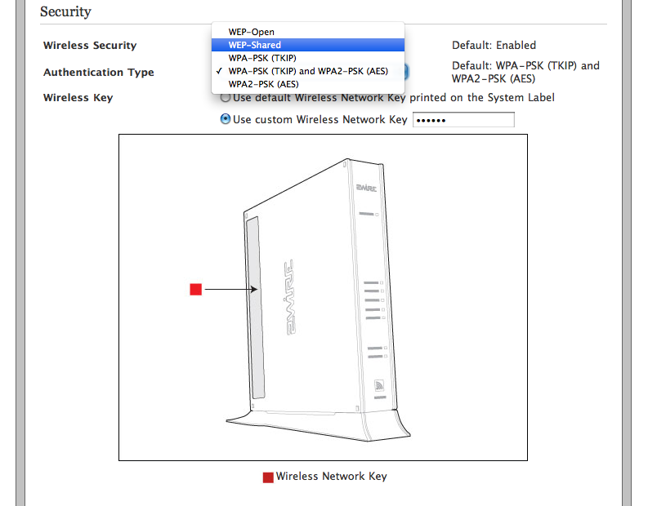
How to fix
Home configuration

Slide 17
Additional Details
TKIP - implements a key mixing function that concatenates the IV with the secret key BEFORE sending it to the RC4 algorithm.
Advanced encryption standard (AES): To solve the repitition problem the AES creates its own finite field (like Finite State machines except with a 4x4 matrix of bytes).

Slide 18
More information
Sample code to simulate the RC4 algorithm: http://www.security-freak.net/encryption/encryption-rc4.html
WEP tutorial with packet injection (needs special hardware) - http://www.aircrack-ng.org/doku.php?id=simple_wep_crack

Slide 19
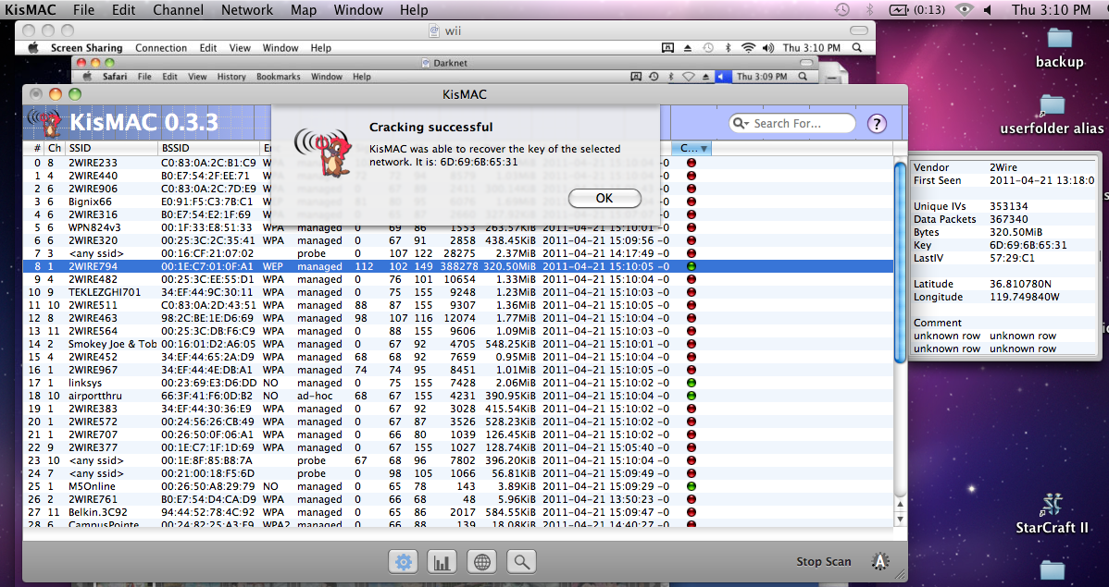
EnD

Slide 20
Sources
All artwork is from[2011] http://www.openclipart.org
WEP algorithm[2011] http://palisade.plynt.com/issues/2006Dec/wep-encryption/
Cracking WEP in detail[2011] - http://palisade.plynt.com/issues/2007Feb/cracking-wep/
Wired Equivalent Privacy (WEP) - http://www.airtightnetworks.com/home/resources/knowledge-center/wep.html

Slide 21
Sources Part 2
ACCESS DENIED[2001] - Cathy Cronkhite and Jack McCullough. Pg 117-139. Network Security Weakness
Cryptography Engineering Design principles and practical applications[2010] - Niels Ferguson, Bruce Schneier Tadayoshi Kohno. Pg 195-211. RSA
Fundamentals of Network Security[2001] - John E. Canavan. Pg. 178, 64-65, 68. RSA, WEP protocol.
Crimeware Understanding New Attacks and Defenses[2008]- Markus Jakobsson, Zulfikar Ramzan. Pg. 122-123, 111. Airsnort Defeating, encryption options for wireless networking.

